Slide 1
Lecture Packet 1
An Introduction to Microbiology
and Basic Chemistry

Slide 2
A. What is microbiology?
- it is the study of organisms that are too small to be seen with the naked eye; the study of microbes or microorganisms
- “bugs” and “germs” are terms usually used by the media to describe microorganisms, but these are NOT generally used by microbiologists any more

Slide 3
Examples of organisms studied by microbiologists:
- viruses
- bacteria
- protozoa
- algae
- fungi
- invertebrate animals (worms and insects)

Slide 4
All of the examples above are currently considered to be living things (organisms) except perhaps one; EXPLAIN*:
VIRUSES do not currently belong to any of the kingdoms of living organisms and they do NOT show all of the characteristics we typically think of when describing an organism.

Slide 5
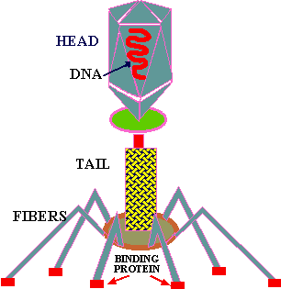
A Bacteriophage Virus
- viruses have no cell parts; there is no cell membrane, cell wall, ribosomes nor organelles (You don’t treat viral infections with antibiotics because of this).
- they also never have DNA and RNA, only DNA OR RNA.

Slide 6
What are the characteristics usually seen in living things?
- they are made of cells
(this is a part of the CELL THEORY which states:
1. all living things are made of cells
2. the smallest living thing is a cell
3. all cells come from pre-existing cells)
- they are highly organized
- they utilize energy (this is why you eat and breathe)
- they reproduce *
- they evolve *
- they have definite life spans
- they respond to stimuli

Slide 7
B. Why Do People Study Microbiology?
1. Should our goal be to eliminate all microbes from the planet?
If we eliminated our normal bacterial flora would there be a consequence?
If we eliminated saprophytic bacteria and fungi, would there be a consequence?
People have studied microbes out of curiosity to find out why they are here and what they do; in so doing, we have found out that life on our planet depends upon microbes.

Slide 8
2. People study microbiology because it has practical $$$$ applications in industry $$$$.
The Food Preparation Industry- packaged, processed and restaurant foods companies are all interested in knowing how microbes will affect their food and the people who eat it.

Slide 9
The Microbial Fermentation Industry makes: bread (Saccharomyces spp.) beer (Saccharomyces spp.) wine (Saccharomyces spp.) vegetables- sauerkraut, pickles, soy sauce, tofu, poi, olives and chocolate ☺ vinegar (Saccharomyces and Acetobacter) fermented milk products such as yogurt (Streptococcus thermophilus and Lactobacillus bulgaricus), cheeses, sour cream, buttermilk

Slide 10
FOOD MICROBIOLOGY
SINGLE CELL PROTEIN sources- Spirulina
Food spoilage and preservation
Dairy food microbiology
INDUSTRIAL PRODUCTS
Pharmaceuticals
Food additives
Enzymes
Bioengineering of transgenic plants and animals to produce hundreds of products
Mining
Biofuels and Industrial Products
Bio-deterioration is another concern for many industries because microbes can destroy the products that they sell.

Slide 11
AGRICULTURAL MICROBIOLOGY
- farming depends upon microorganisms
WASTE DISPOSAL and POTABLE WATER
- Aquatic microbiology
- sewage treatment and water treatment requires a knowledge of microbes
BIOREMEDIATION
- an “up and coming” industry that attempts to find microbes which can be used to solve environmental problems

Slide 12
3. Microbes are easy to study and are used for RESEARCH PURPOSES.
- microbes are small, simple, inexpensive, reproduce rapidly and are adaptable
- the biochemistry and genetics of all living organisms is basically the same
- much of current technology depends upon the research done using microbes
- Biotechnology and Genetic engineering

Slide 13
4. you will be microbiologists for the rest of your lives as HEALTH PROFESSIONALS!
- Public health microbiology, epidemiology, immunology
- treatment (tx) of infectious diseases makes your knowledge of microbial pathogens crucial to the care of your patients, and to yourself, your family and your friends.
- prevention (px) of the spread of disease is mandatory in the medical professions.
- tx of immunocompromised patients is becoming more common for a variety of reasons and you must think about aseptic technique!

Slide 14
You will need to understand the epidemiology of disease and be familiar with the following organizations involved in confining the spread of infectious diseases:
CDC = Centers for Disease Control and Prevention www.cdc.gov
NIH = National Institute of Health
WHO = World Health Organization
USPHS = United States Public Health Service

Slide 15
Characteristics of Microbes
Prokaryotes: have no defined nucleus or membrane bound organelles; they include:
- bacteria and cyanobacteria (blue green algae)
Eukaryotes: have a defined nucleus and membrane bound organelles; they include:
- protists, fungi, plants and animals

Slide 16
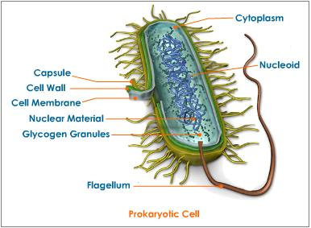
Prokaryotic cells

Slide 17
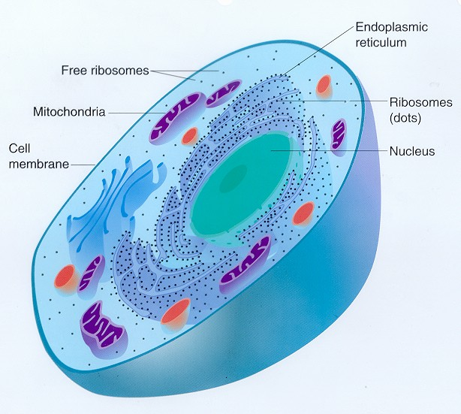
Eukaryotic Cells

Slide 18
Most microbes, such as bacteria, are measured in micrometers (μmeters) (microns); one micrometer is one millionth of a meter.
Some helminths (worms) are measured in millimeters (mm) which is one thousandth of a meter.
Viruses are measured in nanometers (nm) which is one billionth of a meter.

Slide 19
ARE MOST MICROBES HARMFUL or HELPFUL??
- most microbes are free living in the environment, many are saprophytes (decomposers)
- only a small percentage are parasites that live off of a host
- you live with your own microbial flora (the helpful microbes that live on and in you)

Slide 20
D. CLASSIFICATION of MICROORGANISMS
Why is the guinea pig called Cavia porcellus, your dog is called Canis familiaris and your cat called Felis domesticus by scientists?
Scientific names are much preferred over common names by scientists because they show relationships between organisms and they are uniform around the world to prevent confusion.
- starfish, crayfish, silverfish, catfish, jellyfish aren’t all fish?
- what do you wear when you see a seahorse?
- are mountain lions and cougars the same animal?
- is Spanish moss a real moss plant?
- is ringworm a worm?

Slide 21
YOUR SCIENTIFIC NAME is Homo sapiens.
The system of naming organisms with 2 words was developed by a Swedish scientist named Carolus Linnaeus and is called binomial nomenclature.
The first name of any scientific name is called the genus name and it is underlined and the first letter is capitalized; the second name of any scientific name is the species name and it is all in lower case but also underlined.
The underlining can be excused if the names are written in italics.
E. coli, Treponema pallidum, Borrelia burgdorferi

Slide 22
There are three DOMAINS into which all living things are classified:
ARCHEA (Kingdom Archaebacteria)
BACTERIA (Kingdom Eubacteria)
EUKARYA or EUKARYOTA
(Kingdoms Protista, Fungi, Plantae and Animalia)

Slide 23
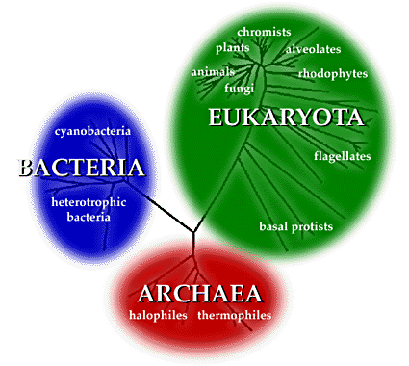
The Three DOMAINS

Slide 24
Within the three domains, currently there are different ways to classify organisms into kingdoms.
KPCOFGS
Kingdom
Phylum (= Divisions in the Plant Kingdom)
Class
Order
Family
Genus
Species
- subspecies, strains, serovars, serotypes

Slide 25
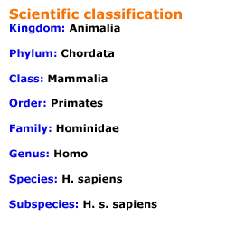
Classification of Humans

Slide 26
We will refer to the 6 kingdom system of classifying living things, but other systems do exist and one day viruses may be included in their own kingdom.
KINGDOM EUBACTERIA
- along with the bacteria in the kingdom Archaebacteria, these bacteria were formerly in one kingdom called the kingdom Monera
- unicellular prokaryotes
- examples include: bacteria, cyanobacteria (formerly blue-green algae)

Slide 27
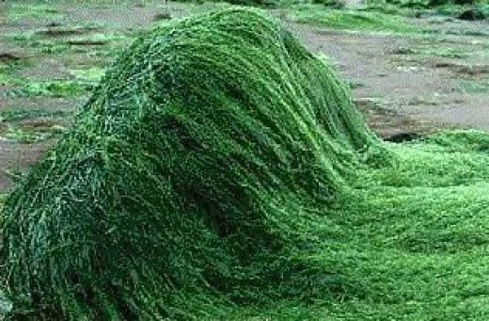
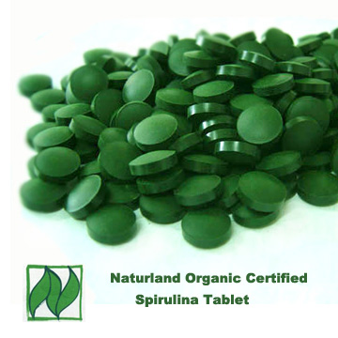
Spirulina is a cyanobacterium, high in nutrients and sold in health food stores in tablet form.

Slide 28
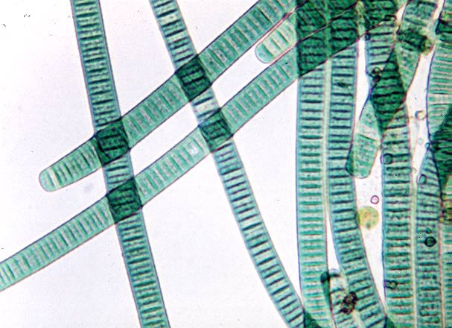
Name the organisms

Slide 29
KINGDOM ARCHAEBACTERIA
- unicellular prokaryotes with unique cell walls that live in harsh environments
(extremophiles)
- they may have been related to earth’s earliest organisms
- examples include: thermophiles, halophiles and methanogens

Slide 30
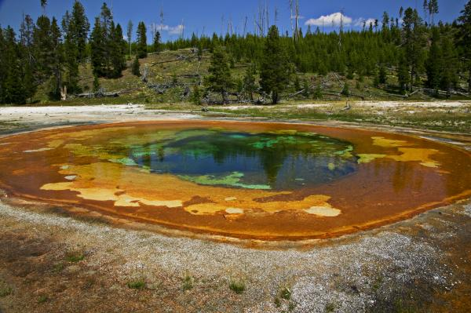
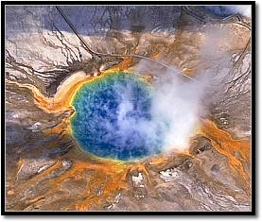

Slide 31
KINGDOM PROTISTA
- unicellular eukaryotes
- examples include: algae, protozoa (amoeba, paramecia) euglena

Slide 32
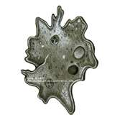
Name the organism

Slide 33
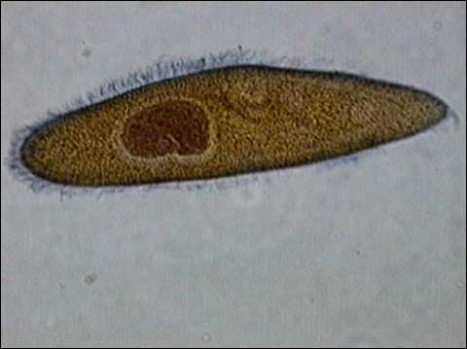
Name the organism

Slide 34
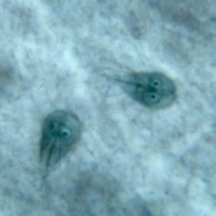
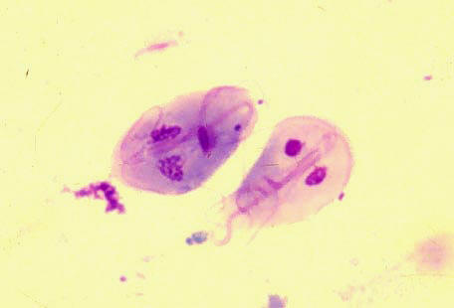
Name the organisms

Slide 35
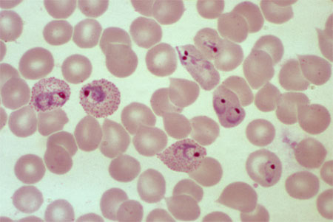
Name the organisms within the RBC’s

Slide 36
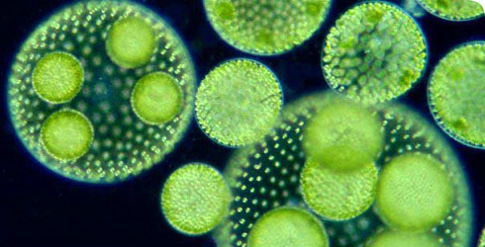
Name the organisms

Slide 37
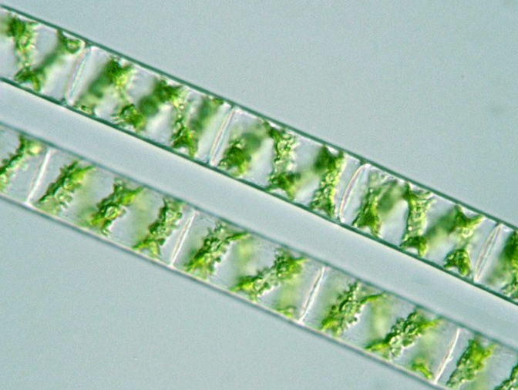
Name the organisms

Slide 38
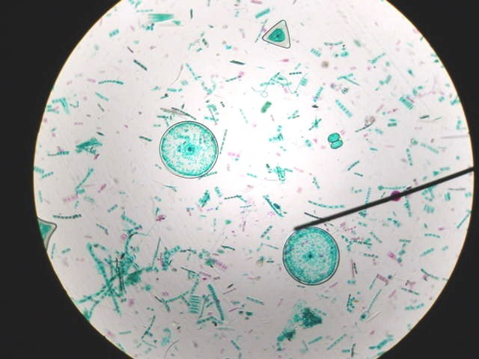
Name the organisms

Slide 39
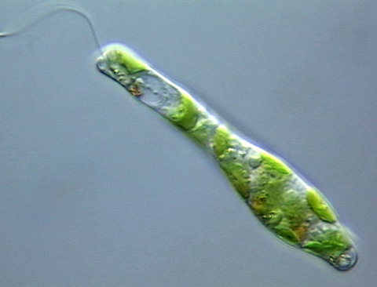
Name the organism

Slide 40
KINGDOM FUNGI
- multicellular (except yeast), eukaryotic, nonmotile, absorptive heterotrophs
- examples include: yeast, mold, mildew, mushrooms, thrush, ringworm,

Slide 41
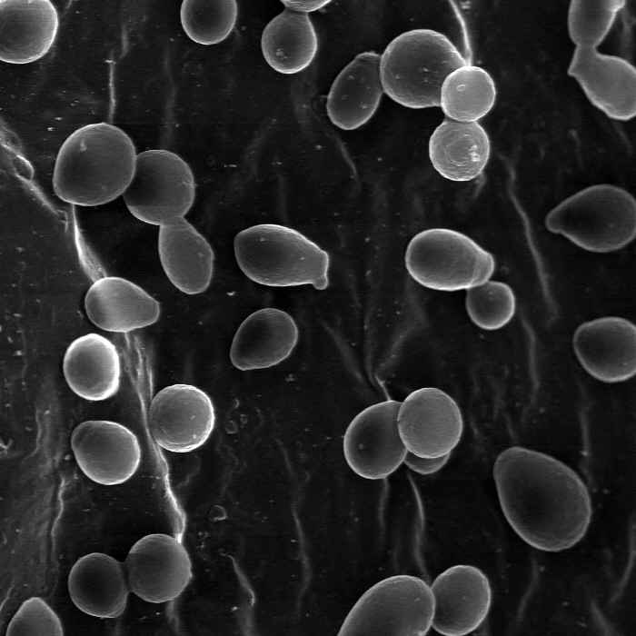
Name the organisms

Slide 42
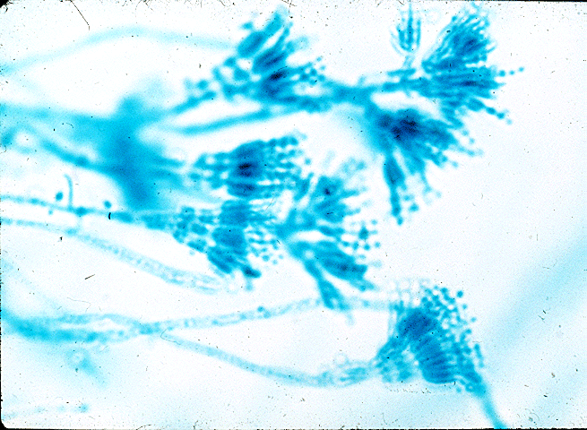
Name the organisms

Slide 43
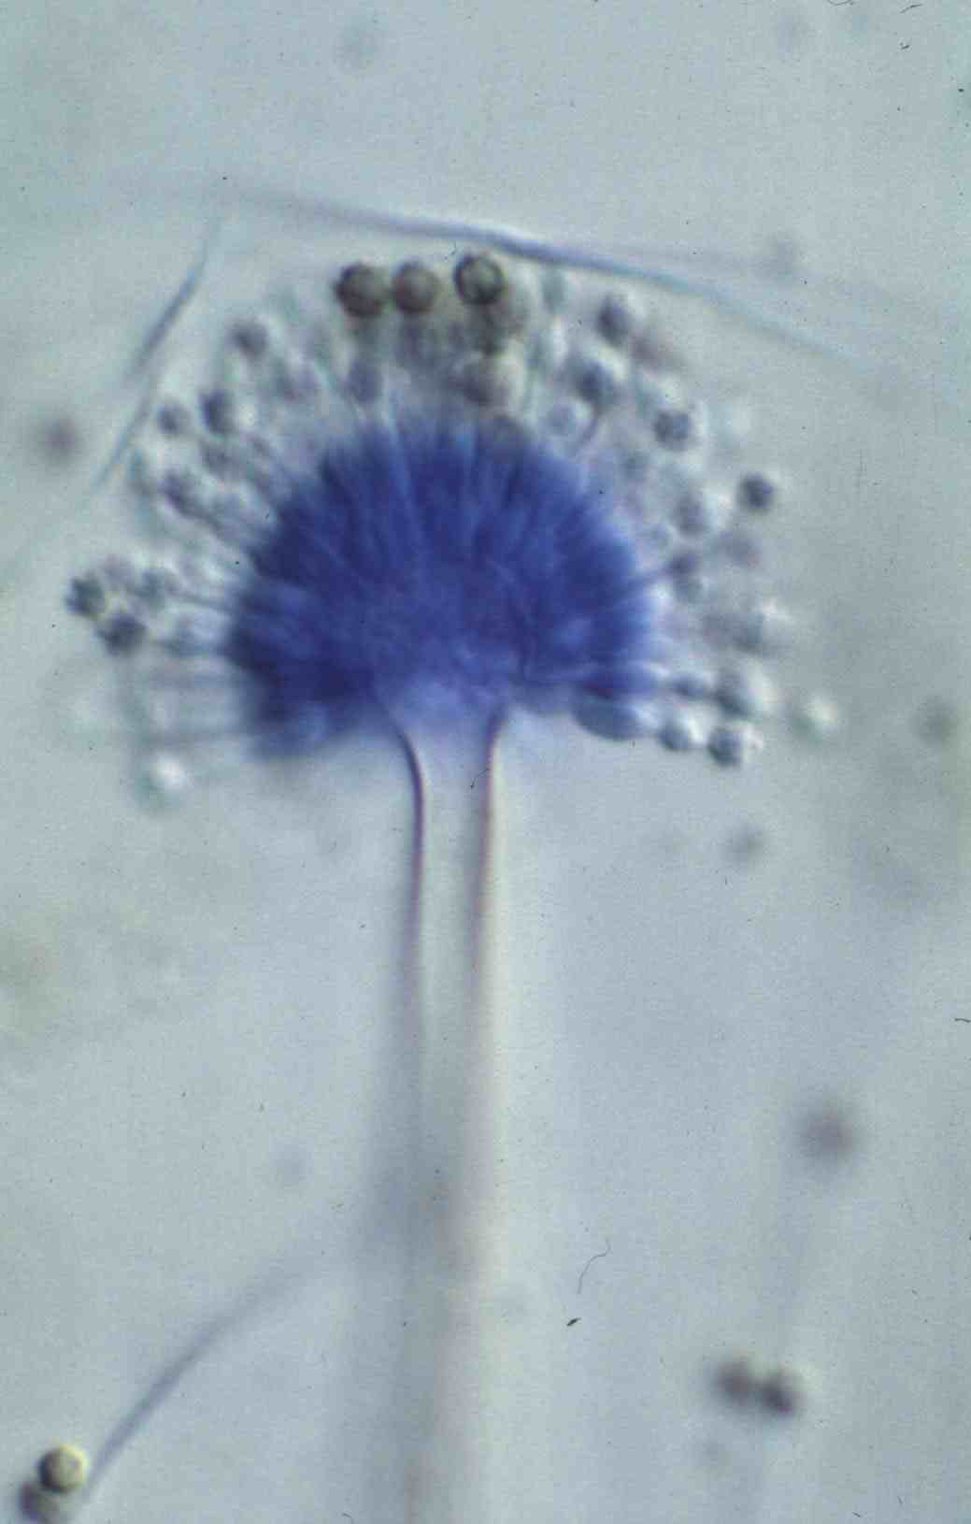
Name the organism

Slide 44
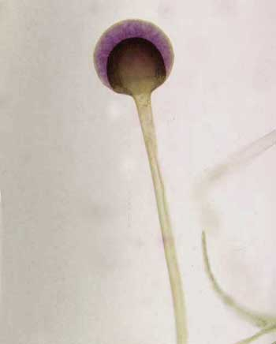
Name the organism

Slide 45
KINGDOM PLANTAE
- multicellular, eukaryotic, nonmotile, photoautotrophs
- examples include: mosses, ferns, cone bearing plants, flowering plants

Slide 46
KINGDOM ANIMALIA
- multicellular, eukaryotic, motile (at some stage in their life cycle), ingestive heterotrophs
- examples include: invertebrates (insects, worms) vertebrates (fish, amphibians, reptiles, birds, mammals)

Slide 47
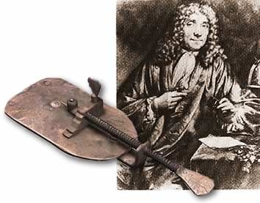
THE HISTORY of MICROBIOLOGY

Slide 48
The advances in microbiology are the compiled efforts of many scientists whose cumulative efforts have allowed us to be where we are today in our knowledge and use of microorganisms.
About 400 years ago, microbiology didn’t exist, it was a mystery; they did though believe in concepts like ABIOGENESIS!!
ABIOGENESIS (spontaneous generation) is the theory that living organisms don’t always have to come from other living organisms.

Slide 49
The first important advancement needed to study microbiology was the development of the microscope.
In the late 1500’s, Zaccharias Jannsen was credited with developing the first compound light microscope; unfortunately these microscopes lacked one important feature critical to a good microscope.
All good microscopes must have: a) good magnification: the ability to make an object appear larger b) good resolution: the ability to see 2 objects, which are close together, as 2 distinct objects and not as one object
(we refer to this as CLARITY or lack of blurriness)

Slide 50
The early Jannsen microscopes lacked resolution.
This problem was amazingly corrected by famous astronomers such as Galileo and Kepler, who transferred their ability to make lenses from telescopes to make lenses for microscopes which had good resolution.

Slide 51
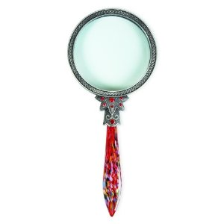
THERE ARE BASICALLY 3 TYPES of MICROSCOPES
SIMPLE LIGHT MICROSCOPES
They have one glass lens, and are also referred to as a magnifying glass.
Most can magnify 2-30 X

Slide 52
B) COMPOUND LIGHT MICROSCOPES
- have 2 or more glass lenses in sequence that are used to look through.
- the total magnifying power of a compound light microscope is determined by: multiplying the ocular lens power X the objective lens power.
- the maximum magnification with a compound light microscope is about 2,000X.
- most microscopic specimens that we see under a compound light microscope need to be stained to see them; staining adds color to normally colorless bacteria but it also KILLS the bacteria.

Slide 53
There are several types of compound light microscopes: a) bright field
- the typical lab microscope b) phase contrast
- allows better visualization of intracellular detail, cilia, and flagella moving in
LIVE specimens c) dark field
- allows us to see difficult to stain microbes and allows the detection of motility
(syphilis used to be diagnosed with this type of microscope) d) fluorescent
- commonly used in diagnostic microbiology and serology (the study of antibodies and antigens in serum and other body fluids)

Slide 54
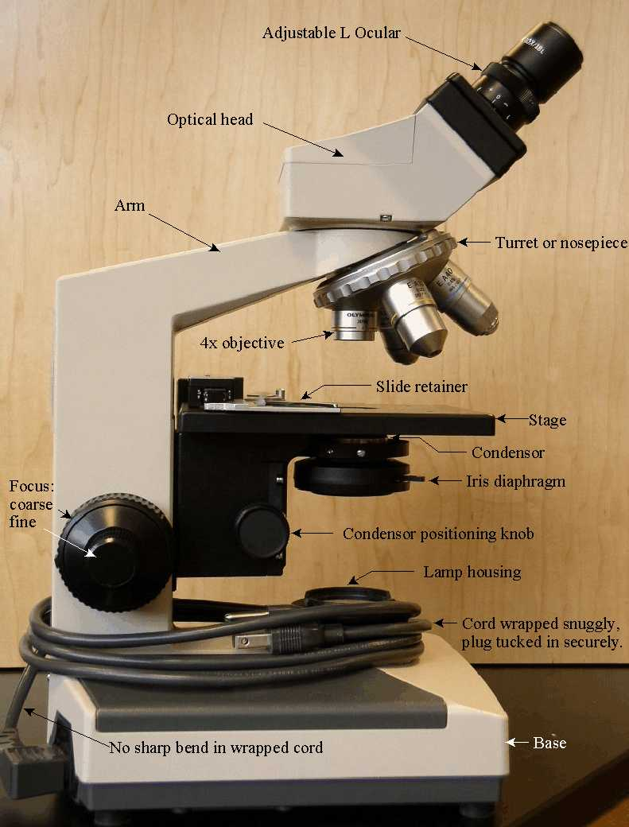
COMPOUND LIGHT MICROSCOPE

Slide 55
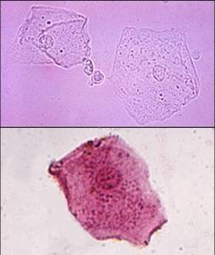
Unstained vs. stained cheek cells looking through a bright field microscope.

Slide 56
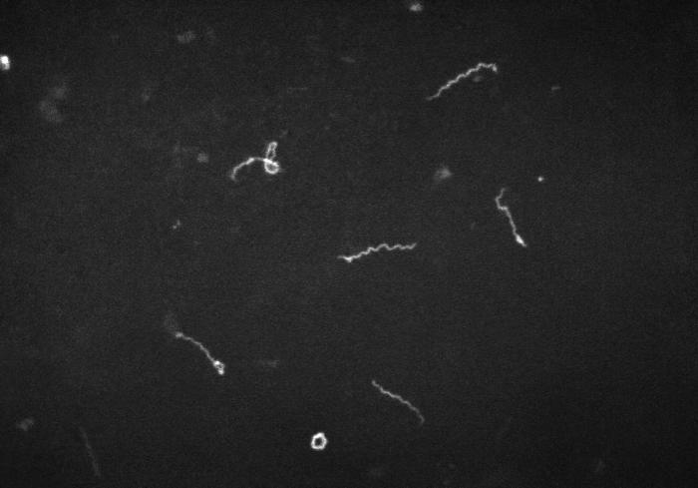
Syphilis spirochetes see through a dark field microscope

Slide 57
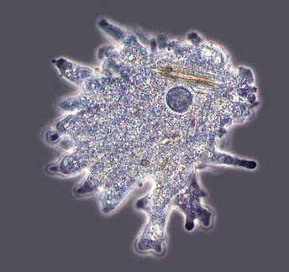
Phase contrast microscopy

Slide 58
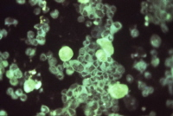
Fluorescent microscopy
Staining to detect cytomegalovirus- the bright green areas are the virus covered with antibodies tagged with a fluorescent dye that target only cytomegalovirus.

Slide 59
C) ELECTRON MICROSCOPES
- electromagnets replace glass lenses, specimens may need to be thin sectioned and they are in a vacuum (the specimen is dead)
- TEM (transmission electron microscope)
- used to see internal details of cells and organelles and to see viruses
- can magnify over 1,000,000 X
- SEM (scanning electron microscope)
- used to see the surfaces of specimens in a “3D” like appearance; can also see viruses
- can magnify up to approximately 100,000 X

Slide 60
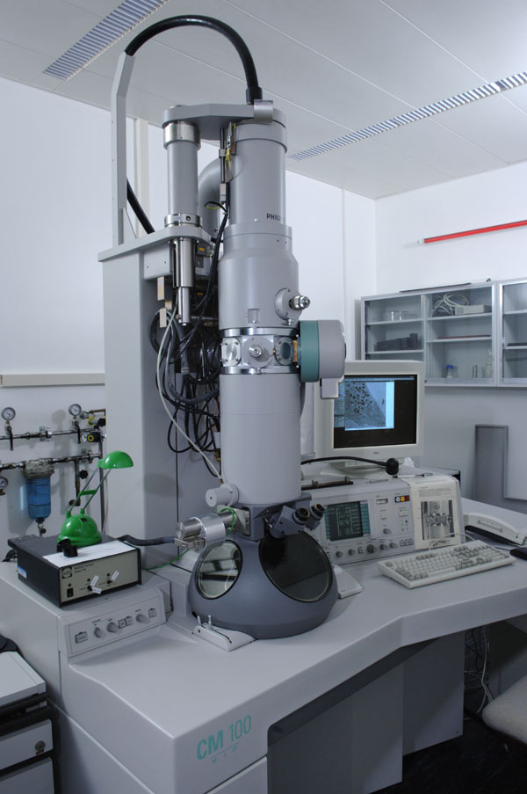
Electron microscopes

Slide 61
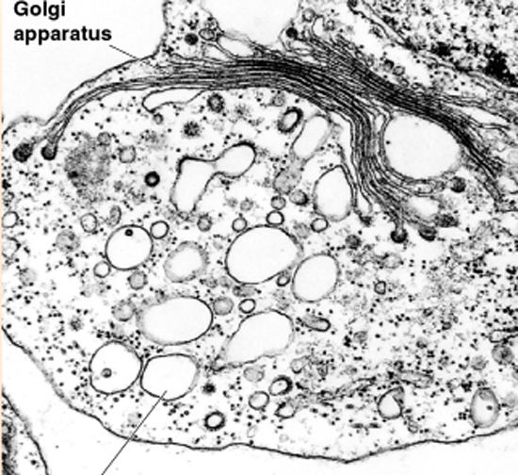
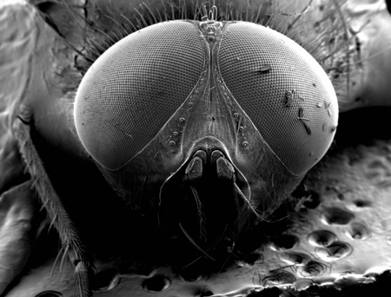
TEM micrograph SEM micrograph

Slide 62
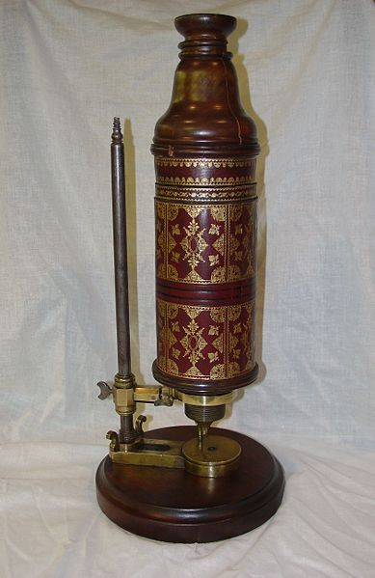
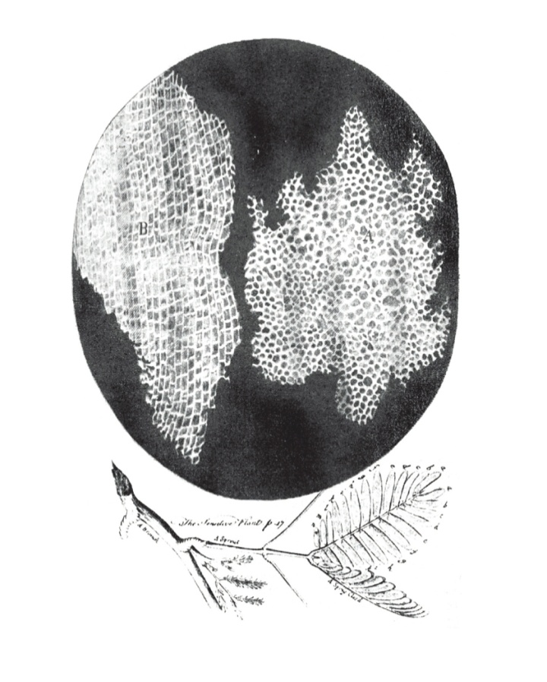
In the 1600’s, Robert Hooke used a compound light microscope when looking at dead cork tissue and was the first to use the term “cell” to describe the basic unit of all living things.

Slide 63
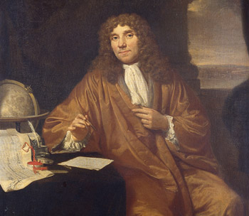
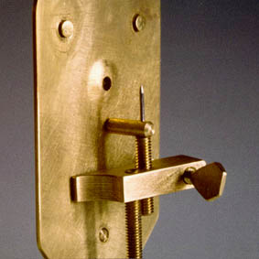
In the 1670’s, Anton van Leeuvanhoek was the first to see, draw and describe “wee beasties” and “small animacules” which were bacteria and protozoa; we consider him the “father of bacteriology and protozoology.

Slide 64
THE GOLDEN AGE OF MICROBIOLOGY
(1857 – 1914)
With the development of the microscope, the age old controversies of spontaneous generation, fermentation and the germ theory of disease were finally solved.

Slide 65
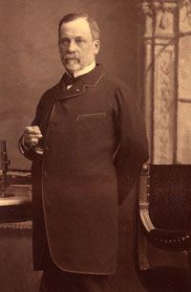
LOUIS PASTEUR (France) – the “father of microbiology”

Slide 66
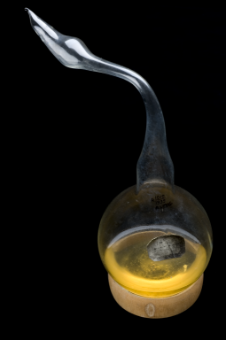
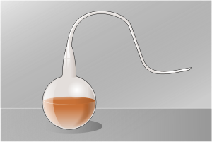
Pasteur disproved the theory of spontaneous generation, as it related to microbes, with his swan neck flask experiments.

Slide 67
Pasteur also discovered how fermentation occurred and that yeast cause the fermentation of grape juice into wine. To save the French wine industry, which was suffering from a problem where many wine bottles started to contain vinegar, instead of wine, Louis Pasteur developed the process of PASTEURIZATION.
Pasteur also determined why vaccines worked and went to work developing vaccines. One vaccine he developed for rabies, led to him being paid a large sum of money, with which he established the Pasteur Institute.
Pasteur was also interested in trying to prove the “germ theory of disease.”

Slide 68
With the discovery of bacteria and proof that biogenesis occurs to create all living organisms, the next major step in microbiology was to prove the
GERM THEORY OF DISEASE.
The germ theory of disease tried to prove that microbes could cause people to get sick.

Slide 69
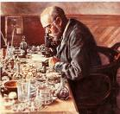
Robert Koch (Germany) – the “father of the microbiology laboratory”

Slide 70
Koch’s Postulates- a method of determining the etiologic agent of infectious diseases.
1. The suspected etiologic agent must be found in every case of the disease and be absent in healthy hosts.
2. The suspected etiologic agent must be isolated in pure culture and identified.
3. The suspected etiologic agent when inoculated into a healthy susceptible host must come down with the same disease as in step 1.
4. The same etiologic agent from step 2 must be isolated and identified in the second diseased animal.
Koch proved that bacteria do cause infection and disease AND with his postulates developed a method to identify which bacteria cause each infectious disease.

Slide 71
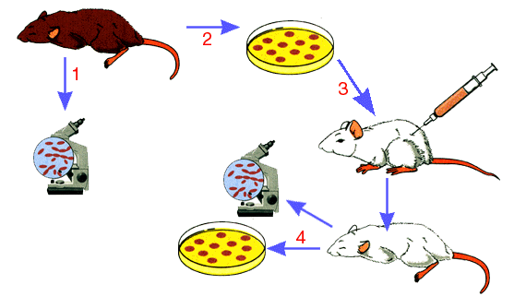

Slide 72
Koch and his colleagues also contributed other advances in the microbiology laboratory including: a) simple staining techniques were developed to see bacteria b) the first photographs of bacteria in diseased tissue were taken c) the use of steam was first used to sterilize media d) the use of agar was first used to solidify bacterial growth media e) aseptic transfer of bacteria using platinum wires was first proposed f) the use of the Petri dish was started

Slide 73
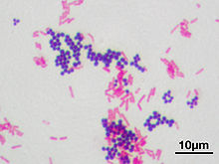
In 1884, Christian Gram (Denmark) developed the Gram stain.

Slide 74
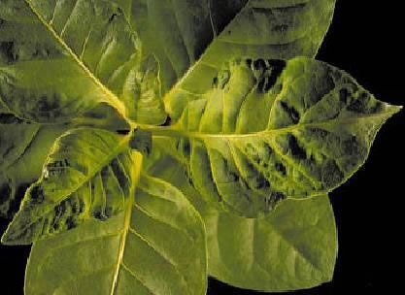
In 1892, Dmitri Ivanovski (Russia) discovered the Tobacco Mosaic virus.

Slide 75
With the proof of the Germ Theory of Disease, the next step in microbiology was to understand how this information could be used to prevent disease in clinical settings.

Slide 76
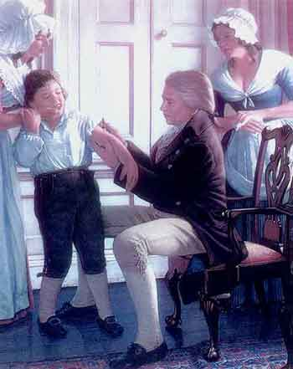
Edward Jenner (England) – in the late 1700’s he developed the first vaccine known in the western world; the vaccine he developed protected people from smallpox.

Slide 77
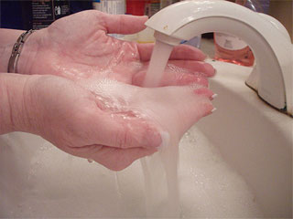
Ignaz Semmelweis (Austria) – in the mid 1800’s he was perplexed over the high numbers of cases or puerperal fever in mothers of newborn babies; he hypothesized that perhaps the doctors delivering the babies should WASH THEIR HANDS!!

Slide 78
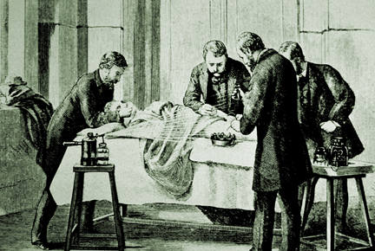
Joseph Lister (England) – in the mid 1800’s he was the founder of antiseptic surgery and the use of antiseptics in health care.

Slide 79
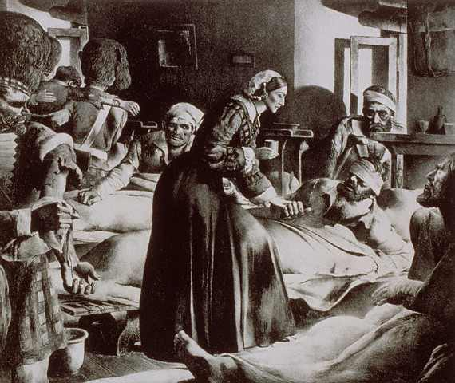
Florence Nightingale (England) in the mid 1800’s she introduced cleanliness and other antiseptic techniques to nursing practice and started nursing education.

Slide 80
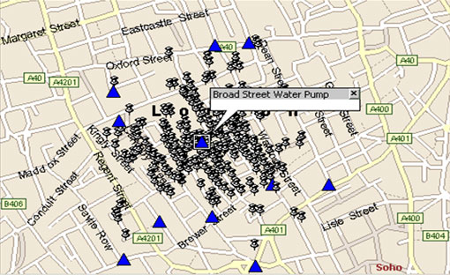
John Snow (England) – in the mid 1800’s he mapped the cases of cholera in London and started the studies of infection control and epidemiology.

Slide 81
Also knowing that microbes cause diseases, microbiologists and physicians began to work to develop chemotherapeutic agents to selectively destroy bacteria to treat humans with infectious diseases.
Selective toxicity – the ability to kill infectious organisms without killing the infected human.

Slide 82
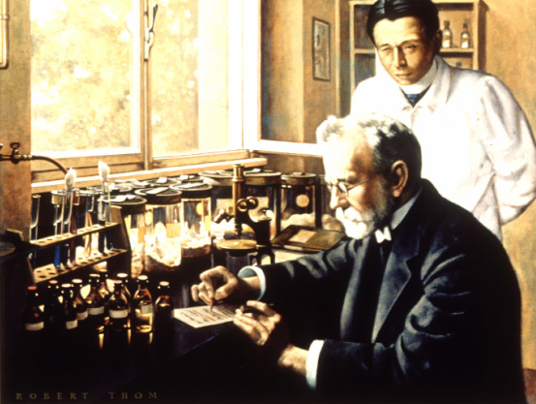
Paul Ehrlich (Germany) – in the early 1900’s he began the study of chemotherapy and developed the first lab synthesized drug, used to treat a disease, that was selectively toxic.

Slide 83

Alexander Fleming (England) – in 1929, he discovered penicillin, the first true antibiotic.

Slide 84
Today, microbiology is in the modern era and has largely untapped room for exploration in the fields of epidemiology, genetic engineering, immunology, vaccines, bioremediation and in industry.
We also must be aware of the dangers associated with some of these advancements as well as the possibilities of using microbes as tools of bioterrorism.

Slide 85
EPIDEMIOLOGY
- the study of the effects of disease on populations, the transmission, incidence and frequency of disease.

Slide 86
The CDC (Centers for Disease Control and Prevention- headquartered in Atlanta) is the main source of epidemiologic information in the U.S.
The CDC publishes the MMWR (Morbidity and Mortality Weekly Report), which provides information on the morbidity (sickness) and mortality (death) due to reportable (notifiable) diseases.

Slide 87
With reportable diseases there is a phenomenon called the ICEBERG EFFECT:
- the number of cases of reportable illness in the MMWR is assumed to underestimate the real number of people in the population with each disease

Slide 88
Disease outbreaks can be classified by their frequency of occurance:
Sporadic = a few isolated cases widespread in a population that occur in an unpredictable manner
Endemic = a constant number of cases seen over a long period of time in a specific region
Epidemic = a drastic increase in the number of cases, beyond what is expected for a population
Pandemic = an epidemic that occurs across continents

Slide 89
Some epidemiologic terms commonly used in medicine:
Symptoms vs. signs of disease, are they different things?
Symptoms are the subjective feelings of the patient and include:
Signs are the objective findings of medical personnel and include:
(Syndromes are diseases that are always accompanied by a specific group of signs and symptoms)

Slide 90
There are certain recognized phases of infectious disease:
Incubation period = the period when an infection first occurs when no signs or symptoms are yet apparent
Prodromal period = the period during an infection when the patient first begins to notice signs and symptoms
Disease period = the period when the infection causes illness (disease)
Decline period = when the signs and symptoms begin to go away
Convalescence period = the period during an infection when signs and symptoms resolve and the patient recuperates

Slide 91

Stages of disease – identify the stages of infection in a person suffering from a cold sore.

Slide 92
Communicable diseases are those diseases that are transmitted
(passed) directly or indirectly from one person to another.
- chicken pox* - herpes simplex I
- measles* - typhoid fever
- tuberculosis (TB)
Contagious diseases* are communicable diseases that can be easily passed from one person directly to another.
Non-communicable diseases are not easily transmitted from one person to another and normally grow outside the body.

Slide 93
Reservoirs of disease are long term animate or inanimate objects that serve as a habitat for an infectious agent.
- a FOMITE is an inanimate (non-living) object that serves as a reservoir of disease; give some examples.

Slide 94
- a VECTOR is an animal that transmits disease.
- zoonotic diseases are infections that animals get and which can be passed on to humans
- vectors can be described as:
MECHANICAL vectors, which passively carry the disease
BIOLOGICAL vectors, where the vector is a necessary part in the transmission of the pathogen and participates in its life cycle

Slide 95
- a CARRIER is a person that transmits disease to another person
- ACTIVE carriers have an overt clinical case of the disease
- CONVALESCENT carriers have largely recovered but continue to harbor large numbers of the pathogen
- ASYMPTOMATIC carriers (= healthy) carry the pathogen but aren’t ill
- INCUBATION carriers incubate the pathogen in large numbers but are not yet ill
- CHRONIC carriers harbor the pathogen for months, years or a lifetime after recovering from the illness

Slide 96
INFECTIOUS DISEASE TRANSMISSION usually occurs in one of the following ways:
CONTACT
- direct: touching, kissing, sexual intercourse
- indirect: fomites
- respiratory droplets that travel less than one meter from the reservoir to the host
VEHICLES
- airborne droplets that travel more than one meter from the reservoir to the host
- waterborne
- food-borne (food poisoning)
VECTORS
- mechanical
- biological

Slide 97
CATEGORIES OF INFECTIONS

Slide 98
1. LOCAL INFECTIONS
2. FOCAL INFECTIONS
3. METASTATIC INFECTIONS
4. PRIMARY INFECTIONS
5. SECONDARY INFECTIONS
6. SUPERINFECTIONS

Slide 99
7. ACUTE INFECTIONS
8. CHRONIC INFECTIONS
9. LATENT INFECTIONS
10. SUBCLINICAL INFECTIONS
11. EXOGENOUS INFECTIONS
12. ENDOGENOUS INFECTIONS

Slide 100
13. NOSOCOMIAL INFECTIONS
14. IATROGENIC INFECTIONS
15. OPPORTUNISTIC INFECTIONS
16. SYSTEMIC INFECTIONS
17. BACTEREMIA
18. SEPTICEMIA
19. TOXEMIA
20. VIREMIA

Slide 101
21. PYOGENIC INFECTIONS
22. PYROGENIC INFECTIONS
23. TERMINAL INFECTION

Slide 102
STUDY THE CHEMISTRY HOMEWORK
WHICH IS ALSO ON LECTURE TEST #1

Slide 103
LEARNING OBJECTIVES FOR LECTURE TEST 1
- be able to cite characteristics which scientists generally use to identify living organisms from non-living things
- be able to give reasons why people study microbiology and list the types of microorganisms
- describe the positive and negative impacts microbes play on human life
- describe the burden of microbial diseases comparing the differences between the developed and developing countries of the world
- explain the importance of microbes in various industries
- define “aseptic technique” and its role in preventing the spread of pathogens
- understand the functions of the CDC, NIH and WHO
- give the characteristics which differentiate prokaryotic from eukaryotic cells
- explain the units of measure needed to measure various microbes
- be able to write and recognize scientific names; tell what is meant by an organism’s genus and species and who was Carolus Linnaeus
- be able to list the levels of classification from domain through species
- explain how organisms are classified in each of the different kingdoms and the characteristics of organisms in each kingdom

Slide 104
- Explain the difference between autotrophs and heterotrophs
- Explain the concepts of abiogenesis, Koch’s postulates, the “germ theory of disease” and selective toxicity
- Explain the major contributions of Jannsen, Van Leeuvanhoek,
Hooke, Pasteur, Koch, Ivanovski, Jenner, Semmelweiss,
Lister, Nightingale, Snow, Ehrlich and Fleming to the field of microbiology
- Be able to compare and contrast different types of microscopes
- Explain what epidemiology is and the role the CDC plays
- Understand the purpose of the MMWR and what the “iceberg effect” refers to
- Be able to distinguish and use the terms sporadic, endemic, epidemic and pandemic when referring to disease outbreaks
- Explain the difference and give examples of signs and symptoms of disease; explain the concept of disease syndromes
- Use the terms incubation, prodromal, infection and convalescent periods of infections properly

Slide 105
- Be able to distinguish between the terms contagious, communicable and non-communicable disease
- Be able to distinguish between fomite, vector and carrier reservoirs of disease
- Be able to explain what zoonotic diseases are and give examples
- Be able to explain how mechanical and biological vectors differ
- Be able to explain how humans acquire infections by contact, vehicles and vectors
- Be able to understand various adjectives that describe infectious diseases
- Be able to discuss and explain all the bold print words in the chemistry homework as well as answer similar questions found in the chemistry homework

